Slide 1
Naïve Bayes
Lecture 05

Slide 2
Probability Basics
Probability is the study of randomness and uncertainty
A random experiment is a process whose outcome is uncertain.
Tossing a coin (head or tail)
Toss 10 coins
Toss a coin repeatedly until you got a head

Slide 3


Event and Sample Space
A sample space, is a set of all possible outcomes of a random experiment.
Simple Event is an event with only one outcome.
Event is a particular collection of outcomes

Slide 4
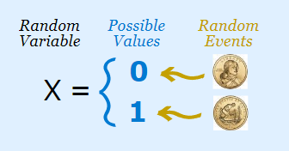
Random Variables
A random variable is a variable whose value is unknown or a function that assigns values to each of an experiment's outcomes.
OR
A random variable, is a variable whose possible values are numerical outcomes of a random experiment.

Slide 5
Random Variables
Random Variables can be either Discrete or Continuous:
Discrete Data can only take certain values (such as 1,2,3,4,5)
Continuous Data can take any value within a range (such as a person's height)

Slide 6
Probability
Probability is associated with an event
Probability is the measure of the likelihood that an event will occur in a Random Experiment.
Probability is quantified as a number between 0 and 1, where, loosely speaking, 0 indicates impossibility and 1 indicates certainty.
The higher the probability of an event, the more likely it is that the event will occur.

Slide 7
Conditional Probability
The conditional probability of an event B in relationship to an event A is the probability that event B occurs given that event A has already occurred. The notation for conditional probability is P(B|A) [pronounced as The probability of event B given A].
P(B|A) = P(A and B) / P(A)
Multiplication Rule 1: When two events, A and B, are dependent, the probability of both occurring is:
P(A and B) = P(A) · P(B|A)
Multiplication Rule 2: When two events, A and B, are independent, the probability of both occurring is:
P(A and B) = P(A) · P(B)

Slide 8
Prior Probability Vs Posterior Probability
Prior Probability in statistical inference, is the probability of an event before new data is collected (i.e. before experiment is performed)
Posterior Probability is revised or updated probability of an event occurring after taking into consideration of new information. It is calculated by updating the prior probability using Bayes’ theorem.

Slide 9

Bayes’ Rule
Bayes’ Theorem (also known as Bayes’ rule) is a deceptively simple formula used to calculate conditional probability.

Slide 10
Bayes Theorem
Bayes’ Theorem is stated as:
P(h|d) = (P(d|h) * P(h)) / P(d)
Where
P(h|d) is the probability of hypothesis h given the data d. This is called the posterior probability.
P(d|h) is the probability of data d given that the hypothesis h was true.
P(h) is the probability of hypothesis h being true (regardless of the data). This is called the prior probability of h.
P(d) is the probability of the data (regardless of the hypothesis).
You can see that we are interested in calculating the posterior probability of P(h|d) from the prior probability p(h) with P(D) and P(d|h).

Slide 11
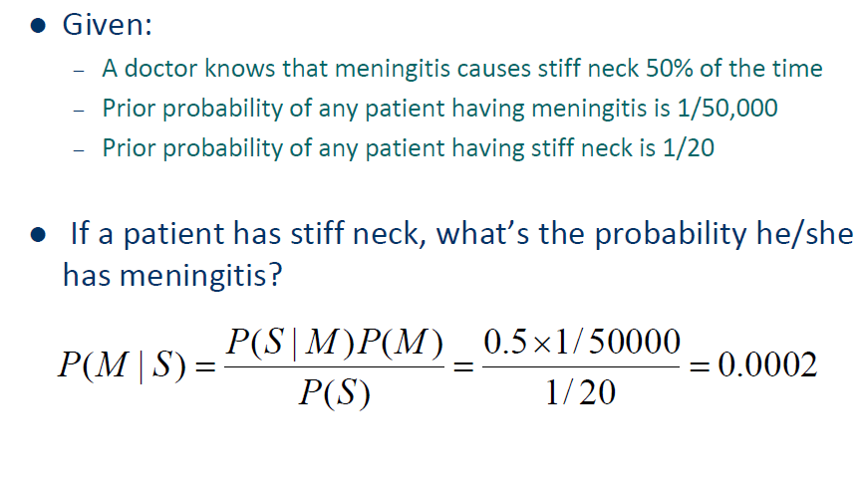
Example of Bayes Theorem

Slide 12
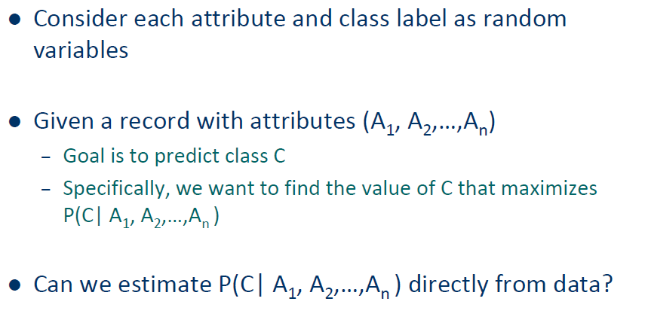
Bayesian Classifiers

Slide 13
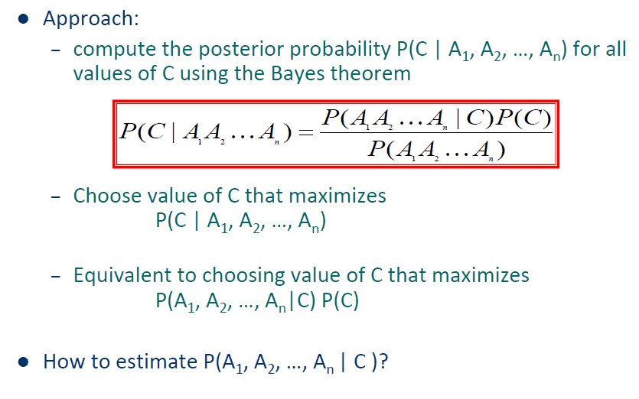
Bayesian Classifiers

Slide 14
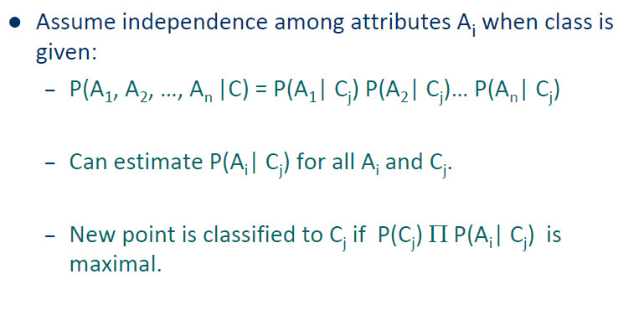
Naïve Bayes Classifier

Slide 15
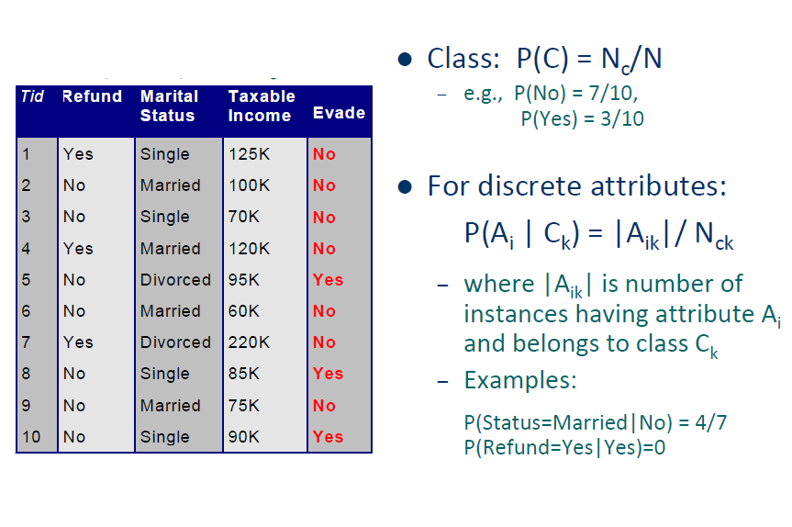
How to Estimate Probabilities from Data?

Slide 16
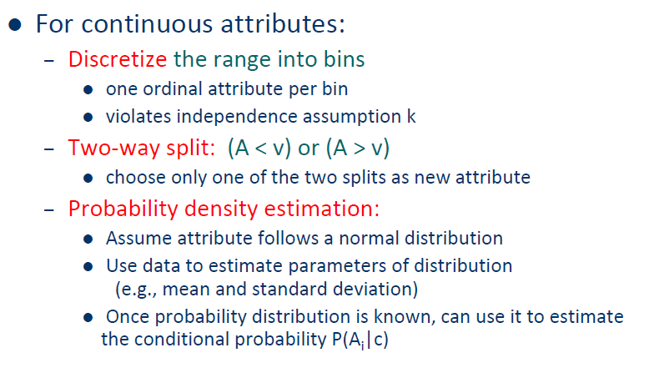
How to Estimate Probabilities from Data?

Slide 17
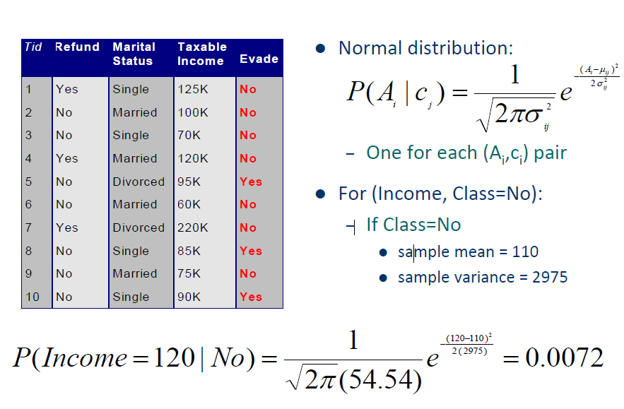
How to Estimate Probabilities from Data?

Slide 18
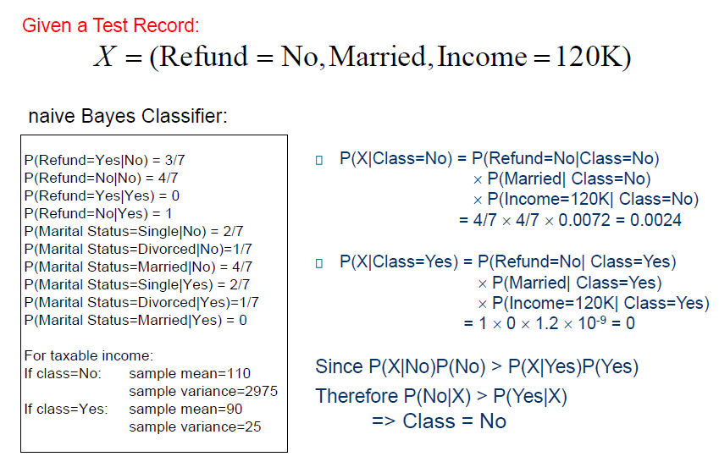
Example of Naïve BayesClassifier

Slide 19
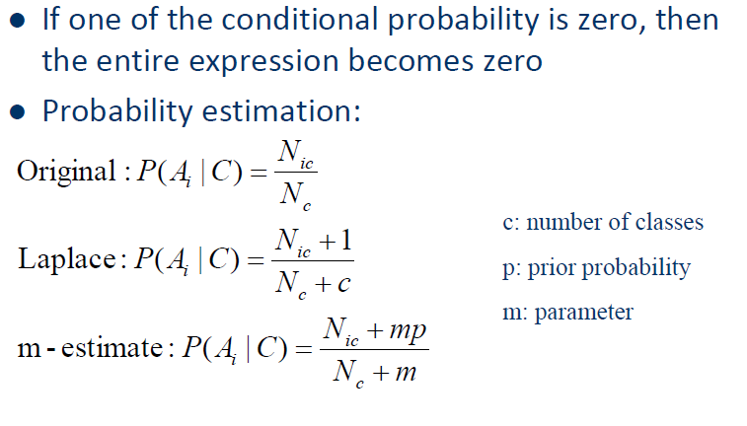
Naïve Bayes Classifier

Slide 20

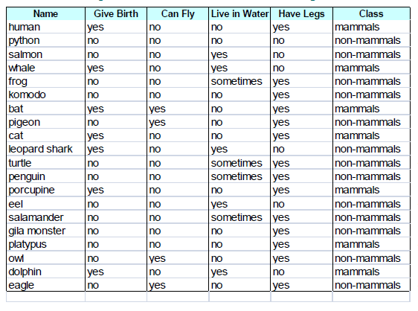
Class Work:

Slide 21
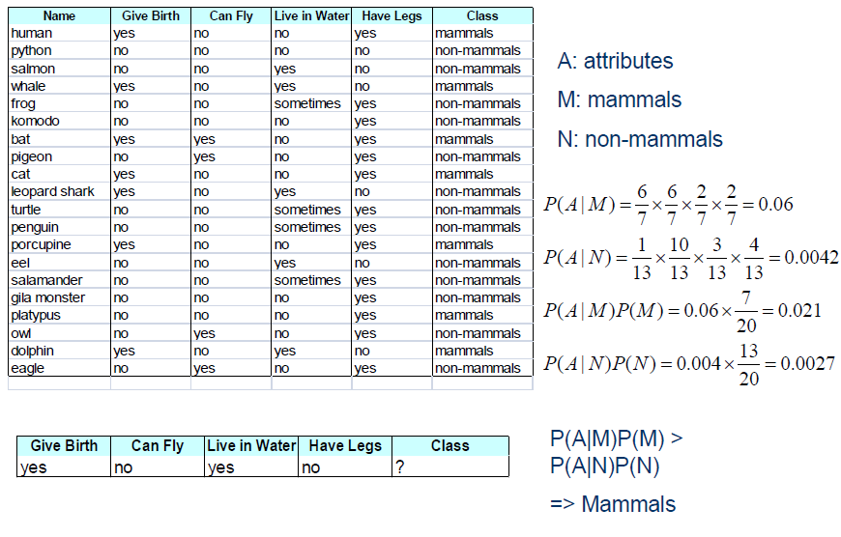
Solution

Slide 22
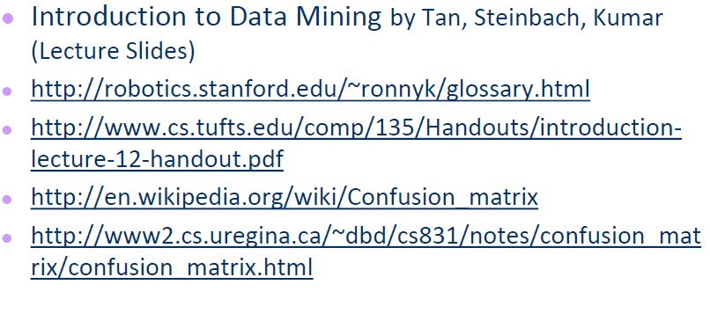
References

